Slide 1
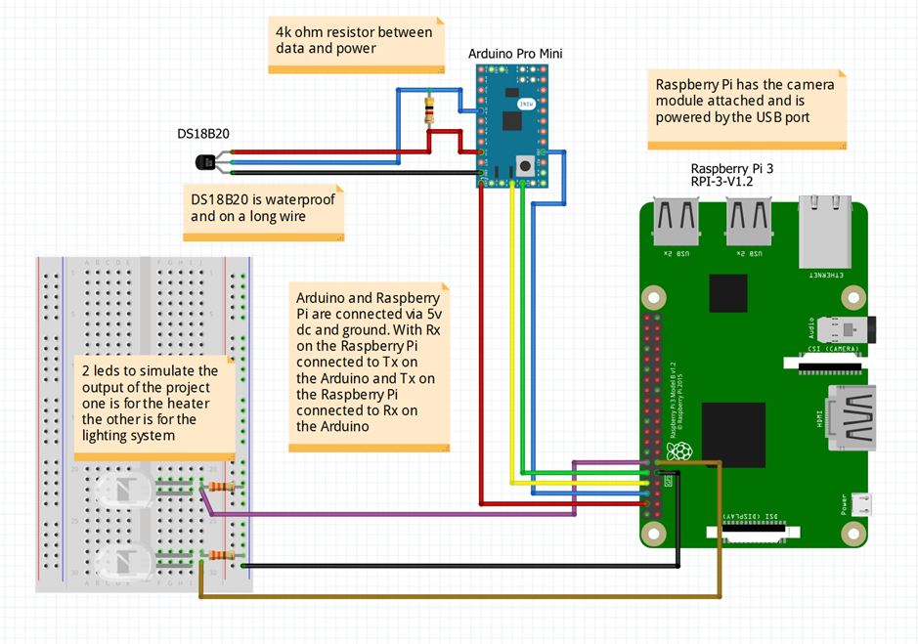
Remote Web-Based Monitoring of the Brewing Process
Matthew David King- supervisor Dr. A. Kalashnikov BEng(Hons) Computer Systems Engineering
Aims and Objectives
The last two objectives, due to a lack of time at the end of the building of the project only LED markers were implemented that were controlled by checkbox by the user on the website’s user interface using AJAX.
An addition to the project was planned and attempted however broke down during the build and could not be completed. This addition was a data logging element using and SQL database called SQLite (SQLite, n.d.) at the time of it working the webserver could write to the database and log data with a timestamp however it could not pull the data from the database and ceased functioning due to a file corruption with the database file no further work was done due to a lack of time.
The main aim of this project is to produce a system that can be used to monitor the brewing process remotely from a webpage using a temperature sensor and a web enabled camera.
Objectives for this project are:
Create a working temperature acquisition system
Setup Raspberry Pi for data acquisition from the Arduino system
Create a completed webpage.
Create a completed automatically updating webpage with video feed and a working webserver solution (prebuilt or custom) with port forwarding network permissions permitting
To create an email-based update system to notify the user of impending changes that need to be made or problems that need solving time permitting an SMS system could be implemented also.
Time permitting a relay and a heating element could be added to be able to fully automate the temperature regulation of the brew
Time permitting create a light source for the camera that will automatically switch on in dark environments.
Conclusions and Next Steps
Throughout this project I have learned a great deal especially on the topic of project and time management. Before completing this project, I had no real knowledge of project management or the importance that it played in the role of ensuring that all elements of the project were completed as a unit. Furthermore, time management had a very large role to play in this project and the way that it turned out.
I also learned new skills in programming in JavaScript due to the fact that I was not able to use the Python programming language in the way that I thought that I could. I also learned, from scratch, creating and maintaining a webserver and website including adding new features and upgrading obsolete ones, programming in HTML, CSS and various forms of JavaScript.
Furthermore, I learned a lot about organising file systems in order to keep projects tidy. I also learned a lot about the usefulness and capability of version controlled external storage as it allowed for easy storage and peace of mind when playing around with new features without the worry of losing a stable working version of code.
A lot was learned about combining multiple smaller and simpler project elements, ideas and systems to create a fully functioning computer system that was fit for purpose and the workload that goes into creating such a system.
Having completed this project there are a number of steps that can be taken to improve it, make it more attractive to use and make it more efficient. The first of these steps should be to add a form of enclosure whether or not that is 3D printed, vacuum formed or some other method of creating an enclosure this project needs it to protect it from splashes and spills and other actions that could damage it. Furthermore, given more time adding in the ability for the project to not only monitor the temperature but regulate it would help with ease of use. This upgrade would include using a 2-channel relay (Appendix 3) system one of the relay channels would be used for the heater and the other channel would be used for the lighting solution this would allow for safe control of electrical systems on a mains supply. Furthermore, adding more temperature probes, such as adding ones for the top middle and bottom of the vessel for getting the most accurate temperature throughout the brew being able to average this would mean that the brew could have its temperature regulated as accurately as possible. Whilst this project functions well at its major function it would benefit from the user being able to look back over previous data from previous brews this would enable the user to craft better beverages and enable them to advance their hobby or profession. The final suggestion for this project is to improve the overall functionality to include the above suggestions and improve the current new code and to improve the user interface to make it more user friendly and more intuitive to use and read.
Project Outcomes
Methodology
Although this project was not fully completed major progress was made into completing the build, more building was scheduled in this project than could feasibly be completed within the given time constraints. Looking back at the aims and objectives of this project and comparing that with the work completed you can see that the majority of this work is completed and that this project is almost at a finished stage.
In terms of the main aim of this project to produce a system that can be used to monitor the brewing process remotely from a webpage via a temperature sensor and a web enabled camera. This can be considered complete for the following reasons.
The first objective was to create a working temperature acquisition system this objective was completed because an Arduino Pro Mini with a DS18B20 was used to acquire temperature data at a rate of one data reading per second and send it to a secondary device.
The second objective, Setup Raspberry Pi for data acquisition from the Arduino system, was met because the Raspberry Pi was setup and running on Raspbian OS with a script that checked the serial interface and it would write the data to the console. This section of the project developed into a section of the webserver that displayed data onto the webpage.
The third objective, create a completed webpage, was met because a webpage written in HTML and styled with an external CSS file this was stored in the appropriate folders.
The fourth objective, create a completed automatically updating webpage with video feed and a working webserver solution with port forwarding network permissions permitting, was completed by building the webpages automatically updating data system and embedding the video feed on the web page. Unfortunately, due to the lack of administrator privileges on the network the port forwarding part of this objective wasn’t possible.
The fifth objective, To create an email-based update system to notify the user of impending changes that need to be made or problems that need solving time permitting an SMS system could be implemented also, was only partially complete. The system for sending SMS messages was not implemented due to a lack of time.
The building of this project started with the Arduino Pro Mini as this was the base for the temperature acquisition system. The program for the Arduino Pro Mini was written in C/C++ and uses two libraries sourced from the Arduino playground. The Arduino was programmed to read the temperature sensor every second and send the data to out along a UART connection.
Following this the Raspberry Pi was setup with Raspbian OS and the unnecessary packages were uninstalled and removed from the system to save space on smaller SD cards. Initially Apache 2 webserver was installed however this solution didn’t work out as planned and was changed for a custom made webserver solution.
The webpage was written in HTML and uses CSS to improve the visuals of the webpage and JavaScript to improve the user interface and the usability. The website is the main users contact point with the project so needs to be as accessible as possible. On the webpage there is an iframe container the houses the video feed there is a section that holds the updating data and the AJAX based controls
The custom made solution was programmed in Node.js JavaScript due to its ease of use and similarity to the syntax of other languages in this project making it easier to learn. and starts up on boot. This webserver also checks the UART connection and sends data to the website using AJAX to reduce the impact to of the refreshing to the user. The AJAX handing code also handles the checkboxes and the button on the webpage. Finally the webserver serves the static asset, the CSS and webpage JavaScript.
Finally, there was an attempt to try to design a data logging side to this system based upon SQLite in the hope that this could create an easy user experience for data logging and eventually data visualisation. However this system could only save data and could not retrieve it. Furthermore this system eventually corrupted the database file. The end aim for this addition was saving data and retrieving it so that it could be visualised on the website in an interactive graph that updated with each new value.

